Slide 1
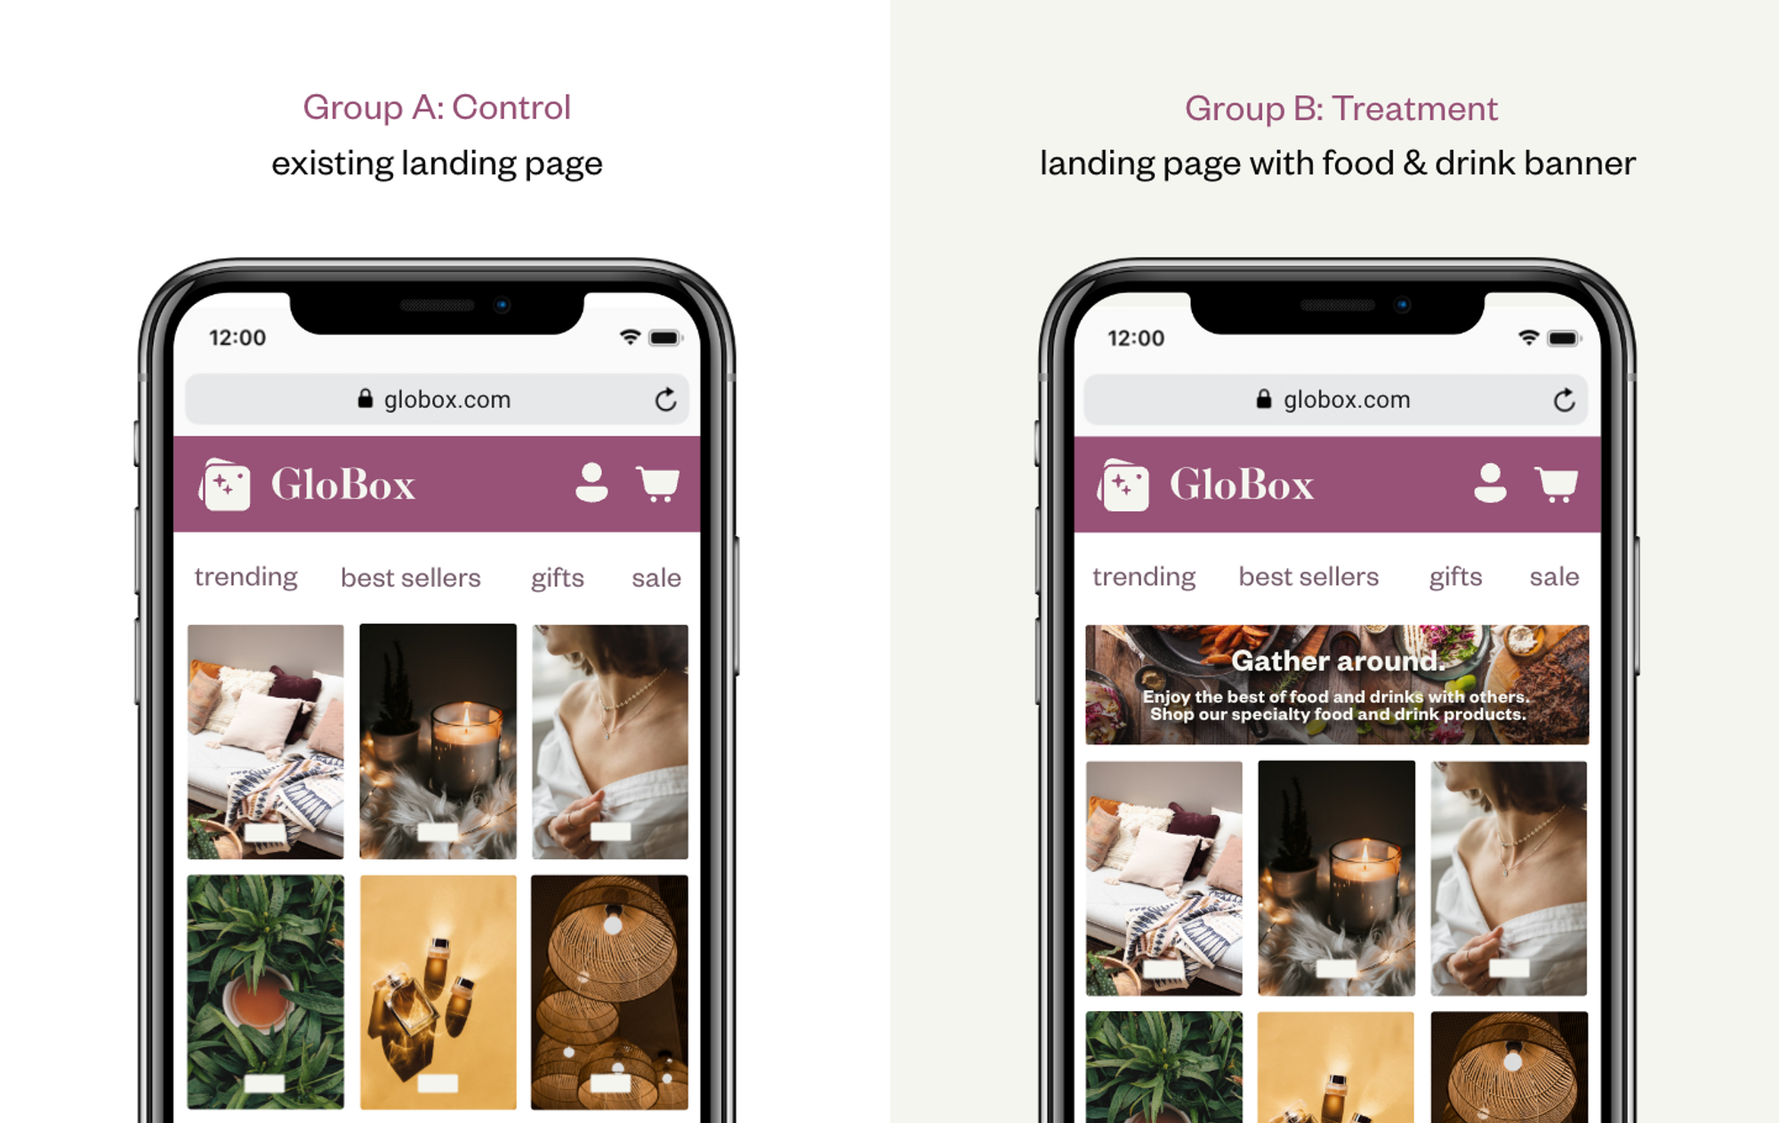
Globox New Banner A/B Testing
By Ninya Narayanan
Thank you Master school mentor

Slide 2
New Homepage Banner
- The Goal: increase revenue of food and drink category .
- A/B Test with 48.9 K users.
- The experiment is only for the mobile website

Slide 3
Inside A/B Testing
Sample size:
-Control: 24,343
- Treatment: 24,600
Mobile User
Control
Treatment
View existing landing page
View landing page with banner
convert
Don’t convert
convert
Don’t
convert

Slide 4
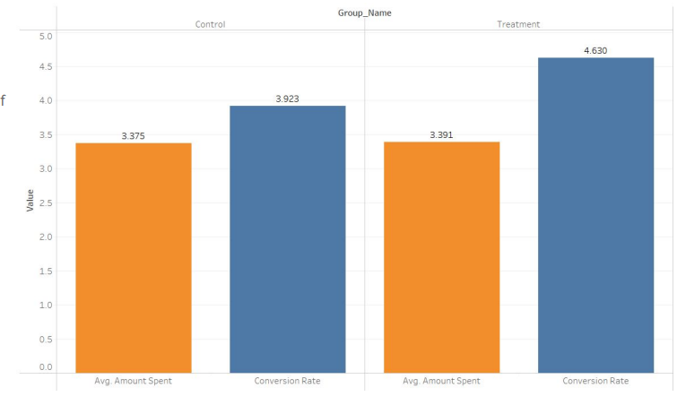
Conversion rate vs Avg amount spent
- Treatment group had a higher conversion rate than Control group (+0.707 %)
-Average Amount Spent was almost similar in both groups with a difference of $0.015

Slide 5
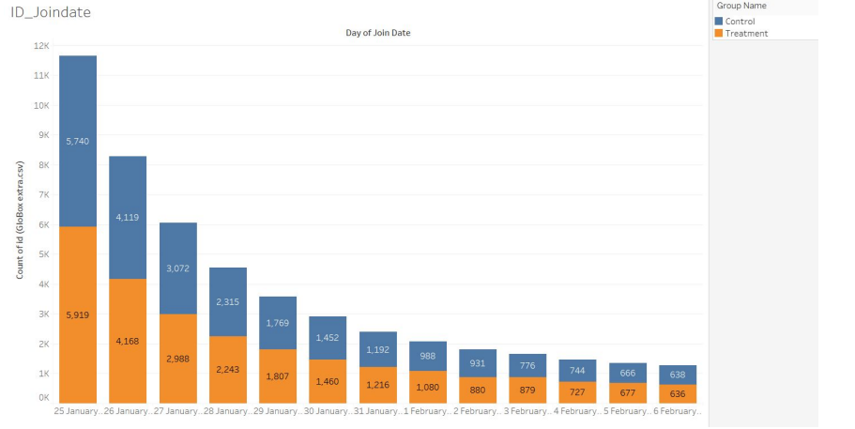
Novelty Effect Assessment
There is no significant difference between the number of users joining each day, no novelty effect can be observed.

Slide 6
Hypothesis Testing
- There is sufficiently strong evidence that the conversion rate was different between the control and treatment group.
- There is no significant difference found in the AVG Amount Spent between the two groups

Slide 7
Conversion Rate Estimates
-I estimate that conversion rate of the Control group lies between 3.67% and 4.16%, while for the Treatment group it lies between 4.36% and 4.89%

Slide 8
Recommendations
I strongly recommend launching the banner because:
- The treatment and the control group have a significant difference in the conversion rates.
- The total amount spent by the Treatment group is higher than the one of control group .
- The cost of launching the new banner is not expensive and combined with the benefits that we saw in the A/B test is worth launching it’

